Slide 1
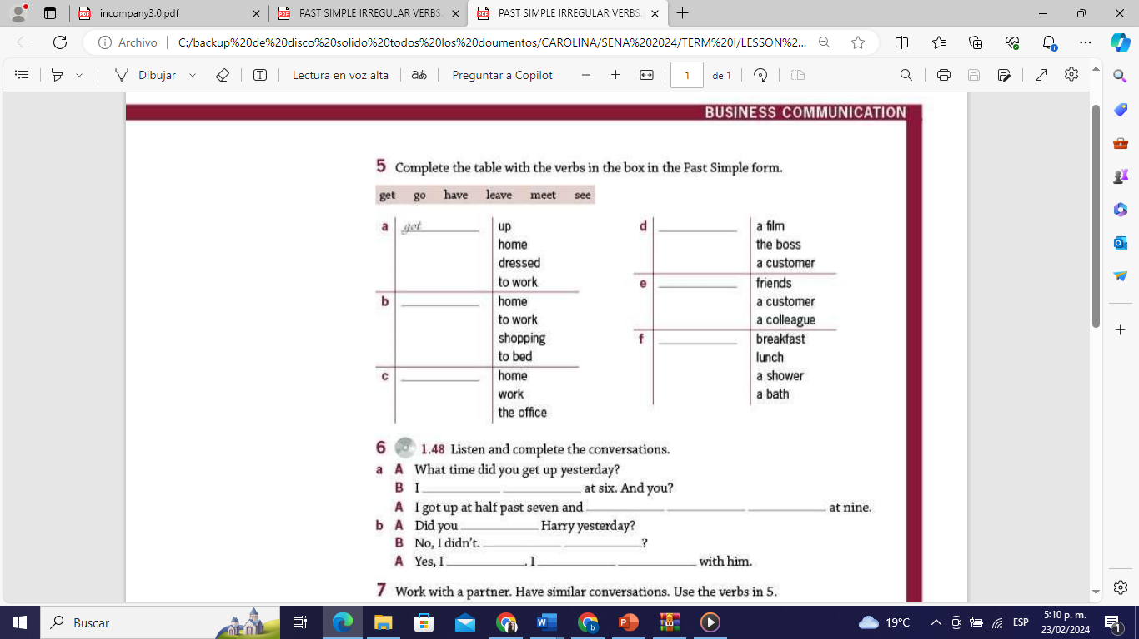
PAST SIMPLE
IRREGULAR VERBS

Slide 2

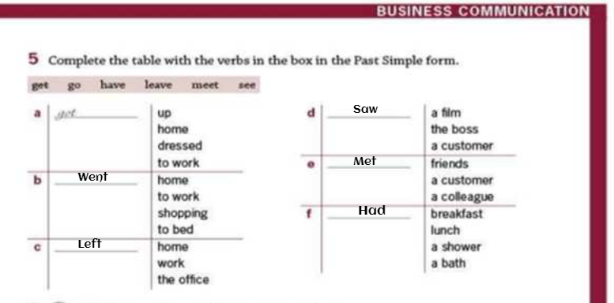

Slide 3
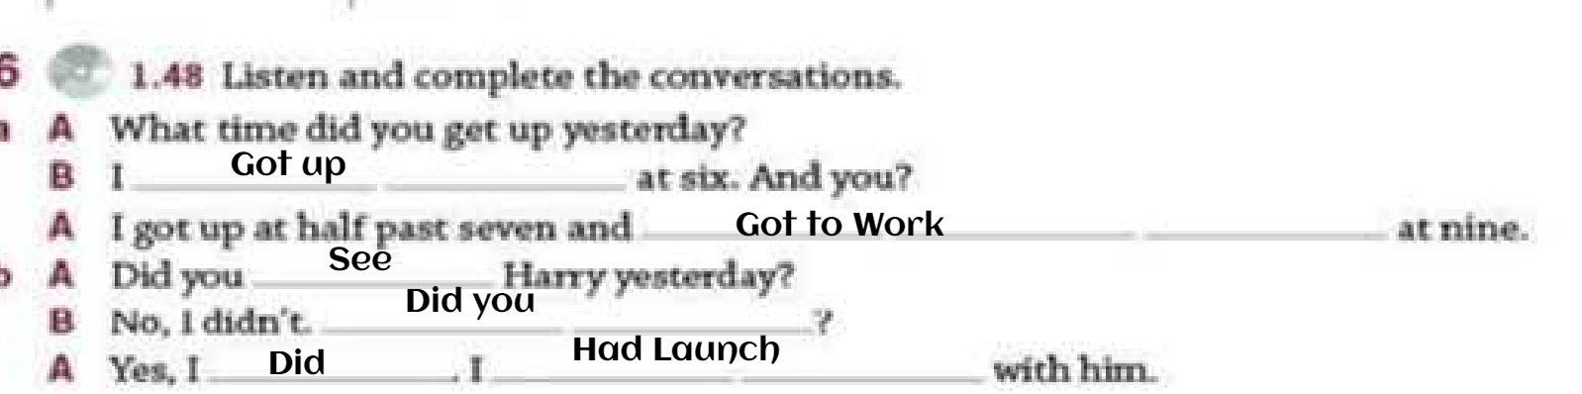

Slide 4
conversation
M :Good morning, what time did you sleep in the last nigth? J :Good morning i slept at 11 pm because my boyfriend wouldn't let me sleep and you? M : Me too slept at 11pm because I played soccer with my "Friends" and my legs hurt, and what did you do this morning? j: I got up at 6 am and I have a breackfast and you? M: I got up at 8 am and I had a breack fast and i had a homework of English class, Have you finished your English homework yet? j: yes I did

